Slide 1
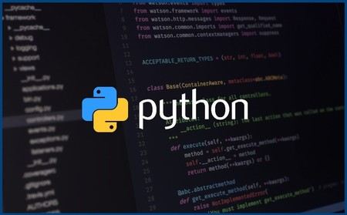
Métodos
Lista en Python

Slide 2



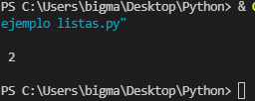


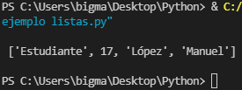
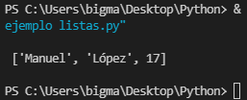
Append()
COUNT()
Reverse()
rEMOVE()

Slide 3








Sort()
Pop()
Insert()

Slide 4




Index()
EXTEND()

